Slide 1
MODULE 2
MODULE 2: SESSION 04
18CS302 – DATA STRUCTURES
SESSIONS | TOPICS
SESSION 1 | List ADT – Singly Linked List
SESSION 2 | Circular Linked List
SESSION 3 | Doubly Linked List
SESSION 4 | Stack ADT
SESSION 5 | Queue ADT
SESSION 6 | Circular Queue
SESSION 7 | Double Ended Queue
STACK ADT
1

Slide 2
STACK ADT
MODULE 2: SESSION 04
18CS302 – DATA STRUCTURES
COURSE OUTCOMES
CO2: | Demonstrate the application of linear data structures on various problems | [AP]
STACK ADT
2

Slide 3
LEARNING OBJECTIVES
MODULE 2: SESSION 04
18CS302 – DATA STRUCTURES
To impart knowledge on the application of stack on various problems.
STACK ADT
3

Slide 4
OUTLINE
MODULE 2: SESSION 04
18CS302 – DATA STRUCTURES
STACK - Definition
Stack Empty Operation
Stack Full Operation
Push Operation
Pop Operation
STACK ADT
4

Slide 5
STACK ADT
MODULE 2: SESSION 04
18CS302 – DATA STRUCTURES
A stack is a list with the restriction that inserts and deletes can be performed in only one position, namely the end of the list called the top.
The fundamental operations on a stack are push, which is equivalent to an insert, and pop, which deletes the most recently inserted element.
The most recently inserted element can be examined prior to performing a pop by use of the top routine.
STACK ADT
5

Slide 6
STACK ADT
MODULE 2: SESSION 04
18CS302 – DATA STRUCTURES
A pop or top on an empty stack is generally considered an error in the stack ADT.
On the other hand, running out of space when performing a push is an implementation error but not an ADT error.
Stacks are sometimes known as LIFO (last in, first out) lists.
The usual operations to make empty stacks and test for emptiness are part of the repertoire, but essentially all that you can do to a stack is push and pop.
STACK ADT
6

Slide 7
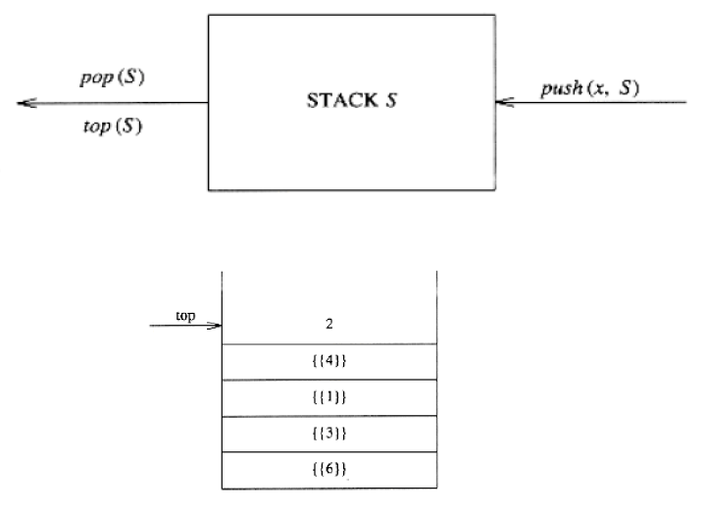
STACK ADT – ARRAY IMPLEMENTATION
MODULE 2: SESSION 04
18CS302 – DATA STRUCTURES
STACK ADT
7

Slide 8
STRUCTURE DEFINITION
MODULE 2: SESSION 04
18CS302- DATA STRUCTURES
The structure declaration of stack is as follows:
struct stack
{
int s[size];
int top;
}st;
STACK ADT
8

Slide 9
STACK EMPTY OPERATION
MODULE 2: SESSION 04
18CS302 – DATA STRUCTURES
Initially stack is empty. At that time the top should be initialized to -1 or 0.
If we set top to -1 initially then the stack will contain the elements from 0th position and if we set top to 0 initially the elements will be stored from 1st position in the stack.
Thus whenever top reaches to -1 we can say the stack is empty.
int stempty()
{
if(st.top==-1)
return 1;
else
return 0;
}
STACK ADT
9

Slide 10
STACK FULL OPERATION
MODULE 2: SESSION 04
18CS302 – DATA STRUCTURES
In the representation of stack using arrays, size of array means size of stack.
As we go on inserting the elements the stack gets filled with the elements.
So it is necessary before inserting the elements to check whether the stack is full or not.
Stack full condition is achieved when stack reaches to maximum size of array.
int stfull()
{
if(st.top>=size-1)
return 1;
else
return 0;}
G.PRIYANKA
STACK ADT 10

Slide 11
PUSH OPERATION
MODULE 2: SESSION 04
18CS302 – DATA STRUCTURES
Push is a function which inserts new element at the top of the stack.
void push(int item)
{
st.top++;/*top pointer is set to next location*/
st.s[st.top]=item;/*placing the element at that location*/
}
The push function takes the parameter ‘item’ which is actually the element which we want to insert into stack.
G.PRIYANKA
STACK ADT 11

Slide 12
POP OPERATION
MODULE 2: SESSION 04
18CS302 – DATA STRUCTURES
The pop function deletes the element at the top of the stack.
int pop()
{
int item;
item=st.s[st.top];
st.top- -;
return(item);
}
The value at the top is stored in some variable as ‘item’ and it then decrements the value of the top, which points to the element which is just under the element retrieved from the stack.
G.PRIYANKA
STACK ADT 12

Slide 13
A stack data structure can be implemented using a one-dimensional array. But stack implemented using array stores only a fixed number of data values. This implementation is very simple. Just define a one dimensional array of specific size and insert or delete the values into that array by using LIFO principle with the help of a variable called 'top'. Initially, the top is set to -1. Whenever we want to insert a value into the stack, increment the top value by one and then insert. Whenever we want to delete a value from the stack, then delete the top value and decrement the top value by one.

Slide 14
Stack Operations using Array
A stack can be implemented using array as follows... Before implementing actual operations, first follow the below steps to create an empty stack.
Step 1 - Include all the header files which are used in the program and define a constant 'SIZE' with specific value.
Step 2 - Declare all the functions used in stack implementation.
Step 3 - Create a one dimensional array with fixed size (int stack[SIZE])
Step 4 - Define a integer variable 'top' and initialize with '-1'. (int top = -1)
Step 5 - In main method, display menu with list of operations and make suitable function calls to perform operation selected by the user on the stack.

Slide 15
push(value) - Inserting value into the stack
In a stack, push() is a function used to insert an element into the stack. In a stack, the new element is always inserted at top position. Push function takes one integer value as parameter and inserts that value into the stack. We can use the following steps to push an element on to the stack...
Step 1 - Check whether stack is FULL. (top == SIZE-1)
Step 2 - If it is FULL, then display "Stack is FULL!!! Insertion is not possible!!!" and terminate the function.
Step 3 - If it is NOT FULL, then increment top value by one (top++) and set stack[top] to value (stack[top] = value).

Slide 16
pop() - Delete a value from the Stack
In a stack, pop() is a function used to delete an element from the stack. In a stack, the element is always deleted from top position. Pop function does not take any value as parameter. We can use the following steps to pop an element from the stack...
Step 1 - Check whether stack is EMPTY. (top == -1)
Step 2 - If it is EMPTY, then display "Stack is EMPTY!!! Deletion is not possible!!!" and terminate the function.
Step 3 - If it is NOT EMPTY, then delete stack[top] and decrement top value by one (top--).

Slide 17
display() - Displays the elements of a Stack
We can use the following steps to display the elements of a stack...
Step 1 - Check whether stack is EMPTY. (top == -1)
Step 2 - If it is EMPTY, then display "Stack is EMPTY!!!" and terminate the function.
Step 3 - If it is NOT EMPTY, then define a variable 'i' and initialize with top. Display stack[i] value and decrement i value by one (i--).
Step 3 - Repeat above step until i value becomes '0'.

Slide 18
STACK – LINKED LIST IMPLEMENTATION
MODULE 2: SESSION 04
18CS302 – DATA STRUCTURES
Stack is a special case of list and therefore we can represent stack using arrays as well as using linked list.
Advantage of implementing stack using linked list is that we need not have to worry about the size of the stack.
Since we are using linked list as many elements we want to insert those many nodes can be created.
The nodes are dynamically getting created so there won’t be any stack full condition.
G.PRIYANKA
D STACK ADT KCT 13 13

Slide 19
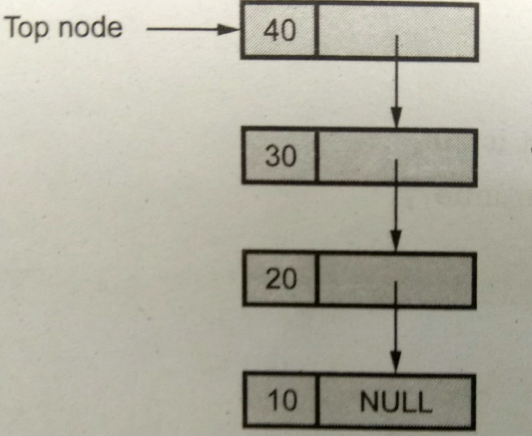
STACK – SINGLY LINKED LIST IMPLEMENTATION
MODULE 2: SESSION 04
18CS302 – DATA STRUCTURES

Slide 20
MODULE 2: SESSION 04
18CS302- DATA STRUCTURES
STRUCTURE DEFINITION
struct stack
{
int data;
struct stack *next;
};
struct stack *top;
Each node consists of data and the next field.

Slide 21
NODE CREATION
MODULE 2: SESSION 04 18CS302- DATA STRUCTURES
struct stack* getnode(int item)
{
struct stack *temp;
temp=(struct stack*)malloc(sizeof(struct stack));
if(temp==NULL)
{
printf("\nMemory not allocated");
}
temp->data=item;
temp->next=NULL;
return(temp);
}

Slide 22
PUSH OPERATION
MODULE 2: SESSION 04
18CS302 – DATA STRUCTURES
void push(int item,struct stack **top1)
{
struct stack *new;
new=getnode(item);
new->next= *top1;
*top1=new;
}

Slide 23
STACK EMPTY OPERATION
MODULE 2: SESSION 04
18CS302 – DATA STRUCTURES
int isempty(struct stack *top1)
{
if(top1==NULL)
{
return 1;
}
else
{
return 0;
}
}

Slide 24
POP OPERATION
MODULE 2: SESSION 04
18CS302 – DATA STRUCTURES
int pop(struct stack **top1)
{
int item1;
struct stack *temp1;
item1=(*top1)->data;
temp1=*top1;
*top1=(*top1)->next;
free(temp1);
return(item1);
}

Slide 25
DISPLAY
MODULE 2: SESSION 04
18CS302 – DATA STRUCTURES
void display(struct stack **top1)
{
struct stack *temp1;
temp1=*top1;
while(temp1!=NULL)
{
printf("%d\n",temp1->data);
temp1=temp1->next;
}
}

Slide 26
Implement a stack using single linked list concept. all the single linked list operations perform based on Stack operations LIFO(last in first out) and with the help of that knowledge we are going to implement a stack using single linked list. using single linked lists so how to implement here it is linked list means what we are storing the information in the form of nodes and we need to follow the stack rules and we need to implement using single linked list nodes so what are the rules we need to follow in the implementation of a stack a simple rule that is last in first out and all the operations we should perform so with the help of a top variable only with the help of top variables are how to insert the elements let’s see

Slide 27
POINTS TO PONDER:
MODULE 2: SESSION 04
18CS302 – DATA STRUCTURES
Stack is a data structure which posses LIFO i.e., Last In First Out property.
Push is a function which inserts new element at the top of the stack.
Pop function deletes the element at the top of the stack.

Slide 28
MODULE 2: SESSION 04
18CS302 – DATA STRUCTURES
KEY TERMS
Stack
LIFO
Push
Pop

Slide 29
LEARNING OUTCOMES
MODULE 2: SESSION 04
18CS302 – DATA STRUCTURES
The students would have gained an insight into Stack Implementation

Slide 30
MODULE 2: SESSION 04
18CS302 – DATA STRUCTURES
NEXT SESSION
STACK

